Slide 1

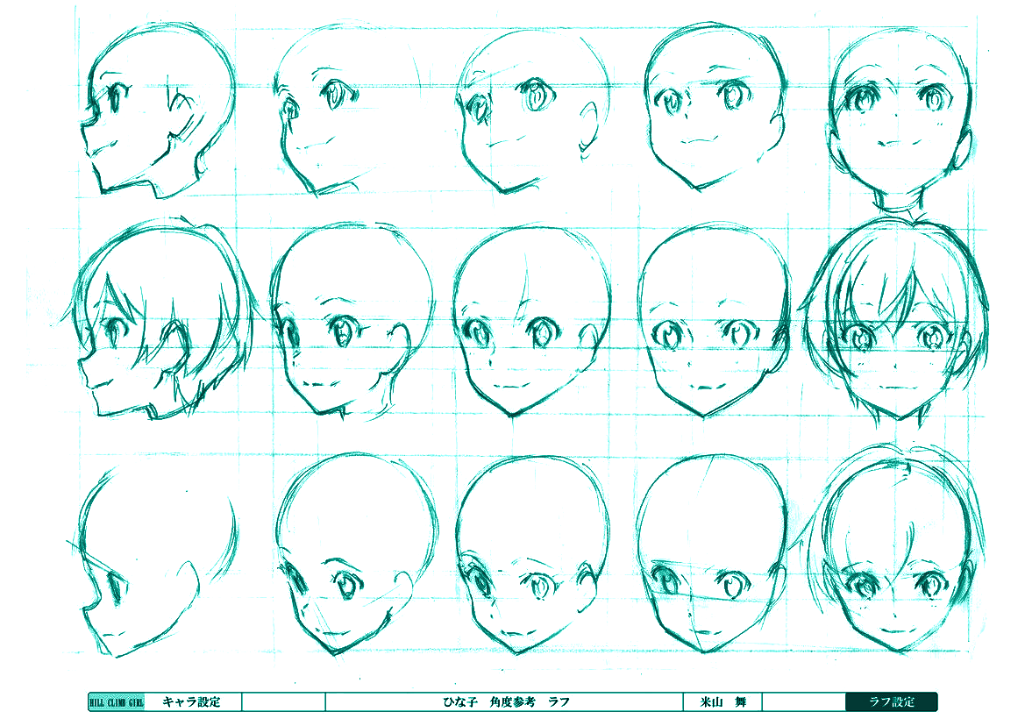
Vision and Perception
-
Project Presentation
Generative Adversarial Network
for generating Anime faces
Gianluca Maselli - 1892187
Damiano Zappia - 1870958

Slide 2

CONTENTS OUTLINE
What GANs are and why we use them
Intro and Motivation
Problem Statement
The purpose of our Generative Adversarial Network
Dataset adopted
Architecture of the Network
Loss Functions
Methodology and Implementation
Plots of Loss functions
Generated Samples
Comparison between real and generated samples
Experiments and results
Conclusions

Slide 3
Intro and Motivation
01
What are GANs and why we use them

Slide 4

Motivation
GANs are, defined by Yann LeCun, “the most interesting idea in the last 10 years in Machine Learning”
They had a huge success since they were introduced in 2014 by Ian J. Goodfellow and co-authors in the article Generative Adversarial Nets
Their ability to generate Images starting from noise makes them “magic” at first sight, making their implementation and use very engaging
GANs are an exciting and rapidly changing field, with the ability to generate realistic examples across a range of problem domains

Slide 5
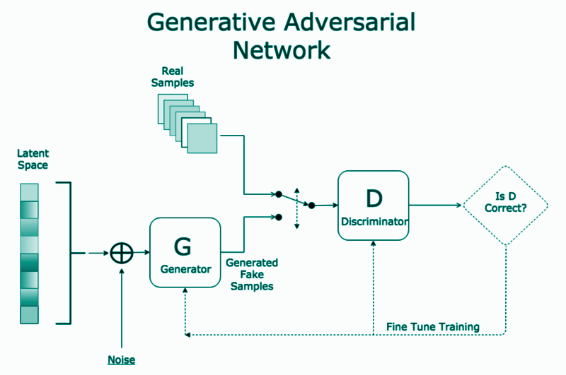
What are GANs
GANs stands for Generative Adversarial Networks, a type of deep learning based generative model, that for its functioning involves two sub-modes, a generator model having the purpose of generating new examples, and a discriminator model with the purpose of classifying whether the samples that it evaluates are real (coming from the domain) or fake (produced by the generator model).

Slide 6
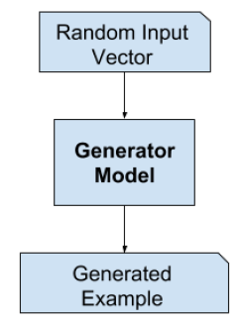
The Generator Model
The generator model takes as input a random vector, of a fixed length, and generates as output a sample in the domain, for example, in our case, an image. The random vector is drawn randomly from a Gaussian distribution and used to seed or source of noise for the generative process. Indeed the input of the generator is a vector of random numbers. After the training, points of this vetor will correspond to points in the problem domain. The vector space is called latent space, a space comprised of latent variables, that are those variables important for a domain but not directly observable.

Slide 7
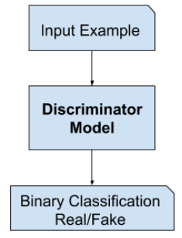
The Discriminator Model
The discriminator model takes an example from the problem domain as input, that can be real (coming from the dataset) or fake (coming from the generator), and predicts the related binary label, assigning real or fake on the basis of its evaluation. Thus it is basically a classifier, in our case a CNN. After the training the discriminator can be discarded, as we are interested in the generator.

Slide 8
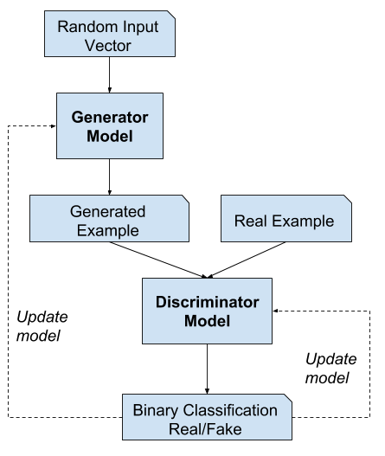
Two Players Game
The two models, the generator and discriminator, are trained together. The generator generates a batch of samples, and these, along with real examples from the domain, are provided to the discriminator and classified as real or fake. The discriminator is then updated to get better at discriminating real and fake samples
in the next round, and importantly, the generator is updated based on how well, or not, the generated samples fooled the discriminator

Slide 9
Problem Statement
02
The purpose of our Generative Adversarial Network

Slide 10
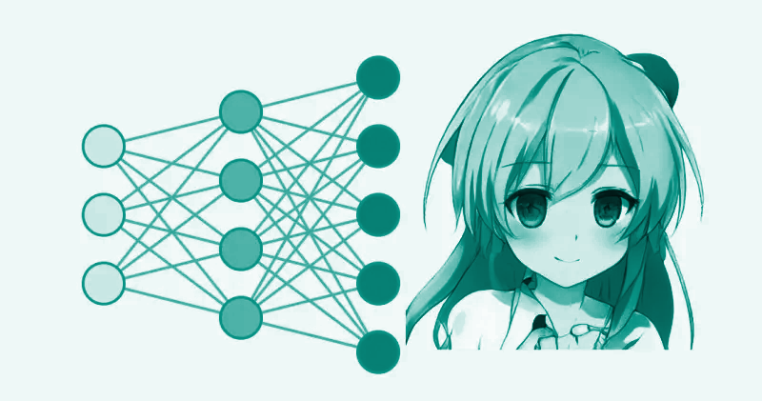
GAN for generating anime faces
The purpose of our GAN is to start from a dataset containing images of anime faces, and generating new faces on the basis of them. So our generator will learn how to create anime faces as much as possible similar to real ones.

Slide 11
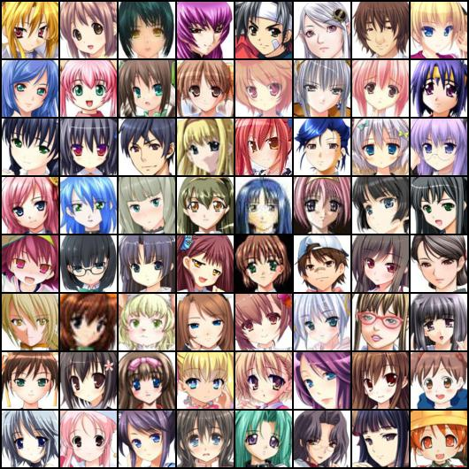
GAN for generating anime faces (2)
The choice of this type of dataset has been done because of both to have a dataset different from the usual datasets that are employed for GANs, and to have still homogeneous images in order to don’t having artifacts due to a lot of diversity into the data

Slide 12
Methodology
and
Implementation
03
Dataset adopted
Architecture of the Network
Loss Functions

Slide 13
Dataset Specifications
The selected dataset for this project, is the Anime-Face-Dataset, available at this url:
https://github.com/bchao1/Anime-Face-Dataset
It containts 63632 high-quality anime faces scraped from www.getchu.com, that are then cropped using an anime face detection algorithm. The images size is variable, indeed we rescale all images to a fixed size before to use them in the network.
We decided to don’t use all the images because of limited resources of google colab (the development platform used), and also because we noticed that using just 40K samples (randomly selected) from the dataset, allows us to achieve good results, better than what expected, thus this choice for the size was valid.

Slide 14
Network Architecture
The network is composed by a generator and a discriminator. The two models are then put together as explained before, with a generator that will always try to generate better and better images, and the discriminator that will try to distinguish them from being real or fake

Slide 15
Generator
A deconvolutional network, that starting from a noise vector of size 100, composed by random normal values, will reshape and transform it to obtain an image of size 128✕128.
It uses for this purpose 7 Conv2DTranspose. 5 layers with a stride of 2✕2 and 2 of stride 1✕1, that starting from a shape of 4✕4, quadruple the area of the input feature maps, until we reach 128✕128 which is the output of the Conv2D layer.
The kernel size for each layer is 3✕3 a part for the last layer which is 5x5. The number of filters is respectively 1024, 512, 512, 512, 256, 256, 128.
The Generator uses Batch Normalization and ReLU activation for the intermediate layers, while it has a Tahn activation for the output layer.

Slide 16

Discriminator
Is a normal Convolutional Neural Network, that starting from images of 128✕128, analyse them using 6 Conv2D.
The number of filters are respectively, 32, 64, 128, 128, 256, 512 . Each of them uses a kernel size of 5✕5 and a stride of 2✕2. In the last Dense layer a dropout of 0.5 is considered. The discriminator uses Batch Normalization and Leaky ReLU activation.
It has the effect of downsampling the input, specifically halving the width and height of the input, resulting in output feature maps with one quarter the area. In other words in each layer Conv2D the output will be the half of the previous layer

Slide 17
Loss
Functions
Two loss functions have been implemented and compared in our GAN model:
Binary Cross Entropy
Mean Squared Error

Slide 18
Binary Cross Entropy
Widely used in GANs models
Implemented as a traditional binary classification problem with labels 0 and 1 for generated and real images respectively.
It measures the performance of a classification model whose output is a probability value between 0 and 1. The loss increases as the predicted probability diverges from the actual label.
Problem of vanishing or small gradients generated when generated images are very different from real images leading to little or no update to the model.
Stability problem.

Slide 19
Mean Squared Error
Try to solve the limitations for using binary cross entropy loss.
The discriminator tries to minimize the sum squared difference between predicted and expected values for real and fake images.
The generator tries to minimize the sum squared difference between predicted and expected values as though the generated images were real.
Benefit in giving more penalty to larger errors, in turn resulting in a large correction rather than a vanishing gradient and no model update.
More stable and better final results.

Slide 20
Experiments and results
04
Plots of Loss functions
Generated Samples
Comparison between real and generated samples

Slide 21
Training Loop
The training loop consists of 500 epochs, each with a batch size of 25 samples. The generator receives a random seed as input and use this seed to produce images. The discriminator then has to classify the samples predicting them as real (from the dataset) or fake (generated). After this the loss is computed for each of the 2 models, and the resulting gradients are used to update the discriminator and the generator.

Slide 22
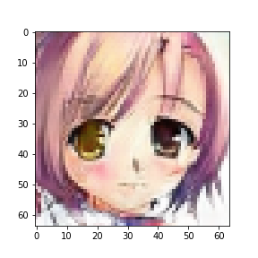
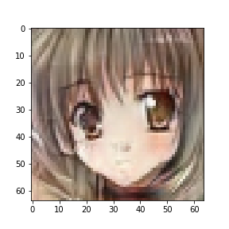
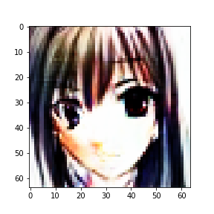
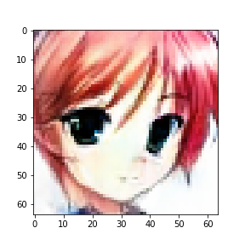
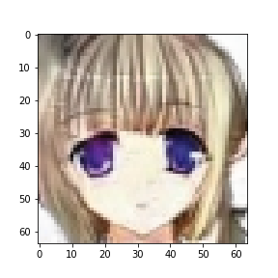
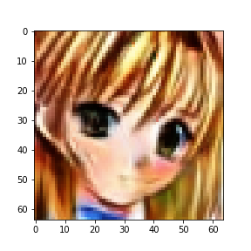
GAN for 64✕64 Images
Removal of the two layer with stride 1✕1
MSE Loss
Faster training
Stable Model
Good result in a short amount of time
Early stopping at 160 epochs

Slide 23
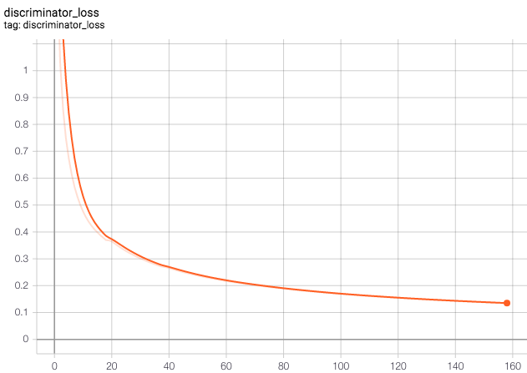
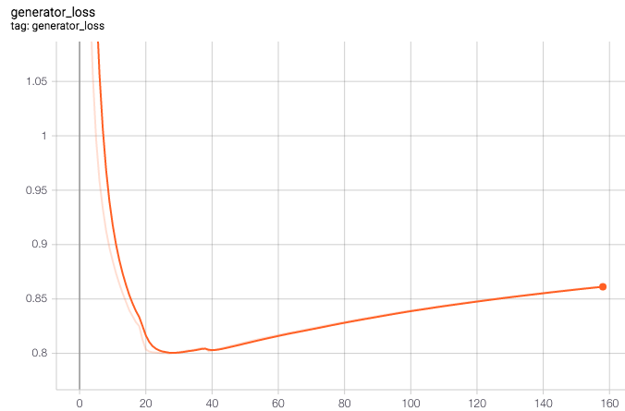
Loss functions plots
MSE loss

Slide 24
GAN for 128✕128 Images
Trying to improve the 64✕64 GAN raising the resolution to 128✕128. Comparison between Binary-Cross Entropy and MSE. Several problems encountered:
Not convergence
Mode collapse
Weak Generator
Slower Training
Discriminator Loss reaching 0 in few steps.

Slide 25
Improvements
01 | 02 | 03 | 04
Added smooth labeling to improve generalization | Added noisy labels, randomly flip labels of real samples | Lowered learning rate to fight mode collapse, using β1=0.5 that helps to stabilize training | Deconvolutional layers with stride 1

Slide 26
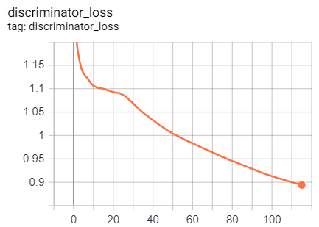
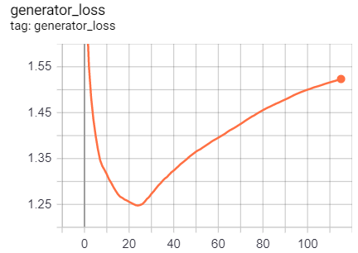
Loss functions plots
Binary Cross Entropy loss

Slide 27
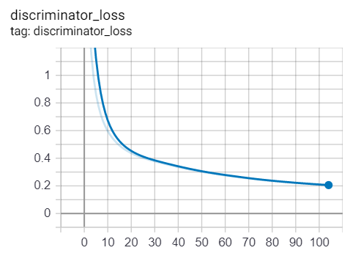
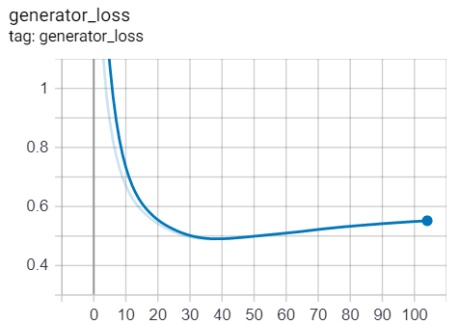
Loss functions plots
MSE loss

Slide 28
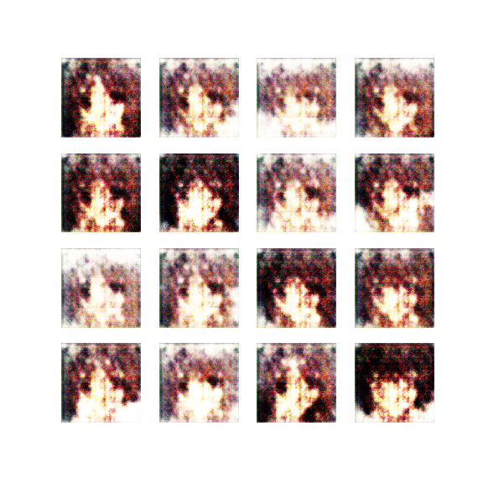
Evolution of Generated 128✕128 Samples

Slide 29
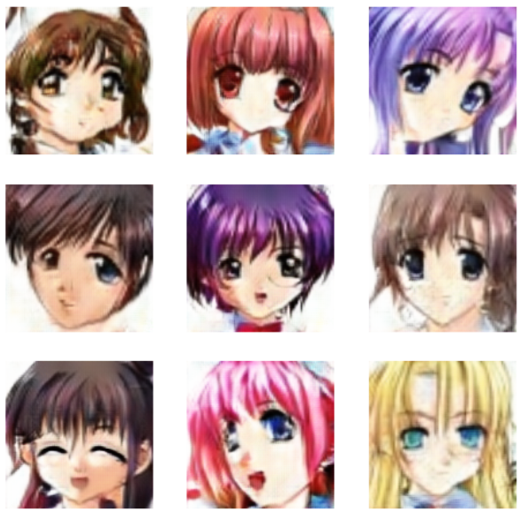
Generated Samples
The generated samples even presenting some sign of artifact, have an overall good level of similarity with respect to the reality.
This means that the designed GAN is able to achieve the goal of the project, thus that the implementation choices revealed to be good

Slide 30
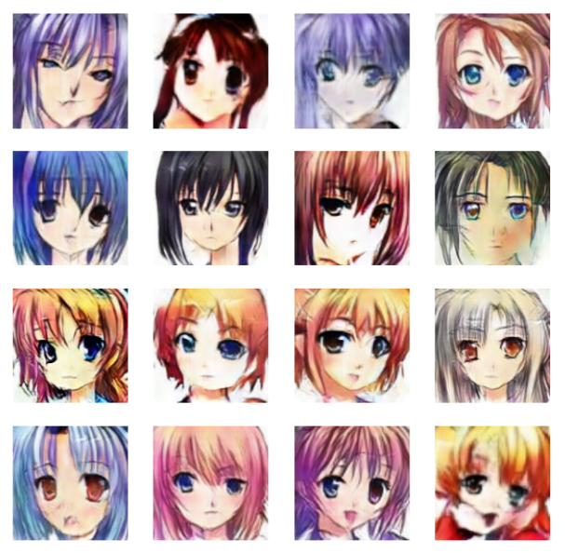
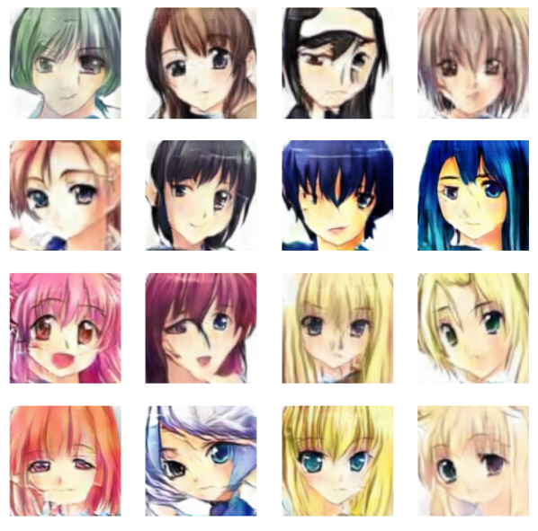
Comparison BCE - MSE
Epoch 58
Epoch 32

Slide 31
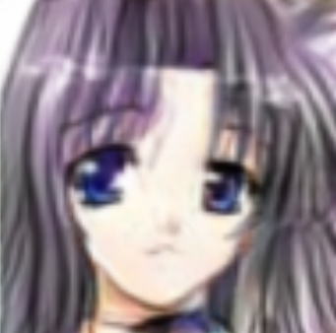
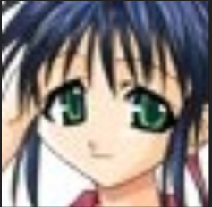
Comparison between real and generated samples
Can you distinguish which one of the two is the real sample and which one is the fake?

Slide 32
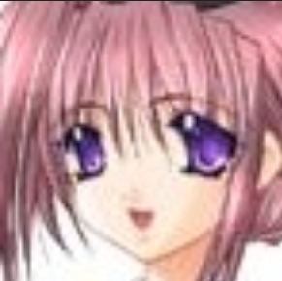
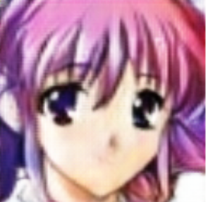
Comparison between real and generated samples
Can you distinguish which one of the two is the real sample and which one is the fake?

Slide 33
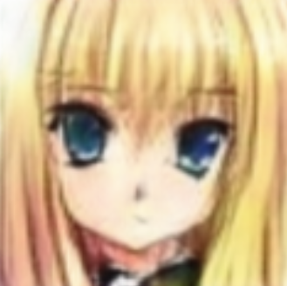
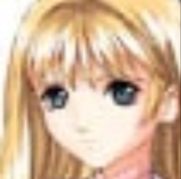
Comparison between real and generated samples
Can you distinguish which one of the two is the real sample and which one is the fake?

Slide 34
Conclusions
05

Slide 35
Conclusions
We developed a GAN application capable of generating with good level of reality anime faces, showing also some relevant particulars like light reflection in eyes or headband.
We also demonstrated the stability of the process even for images of 128✕128, higher than the stability limit for DCGANs, that is normally set up to 64✕64
Thus we showed the potential of this kind of generative model, and we can be really satisfied of our first experience with GANs

Slide 36


